Slide 1
CHGM-141
General and Analytical Chemistry I
Lecture 25 (b)
(Ch.9) with Dr. Bailey
Sample-Practice Problems
(Gases)

Slide 2
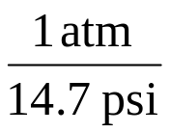
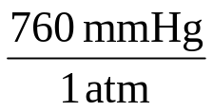
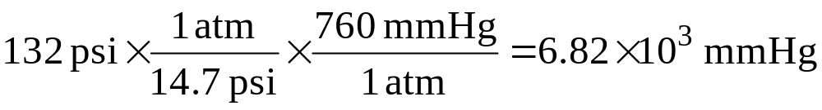
Example 1 – A high-performance bicycle tire has a pressure of 132 psi. What is the pressure in mmHg?
Given:
Find:
132 psi
mmHg
Concept Plan:
Relationships:
1 atm = 14.7 psi, 1 atm = 760 mmHg
psi
atm
mmHg
Solution:
Check:
since mmHg are smaller than psi, the answer makes sense

Slide 3
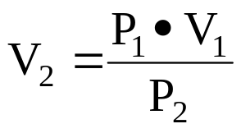
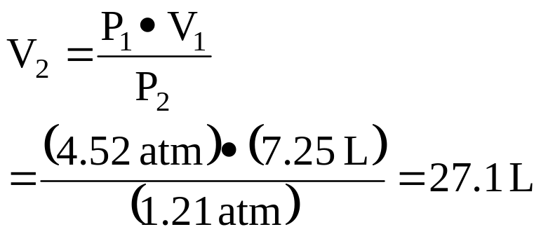
Example 2 – A cylinder with a movable piston has a volume of 7.25 L at 4.52 atm. What is the volume at 1.21 atm?
Given:
Find:
V₁ =7.25 L, P₁ = 4.52 atm, P₂ = 1.21 atm
V₂, L
Concept Plan:
Relationships:
P₁ ∙ V₁ = P₂ ∙ V₂
V₁, P₁, P₂
V₂
Solution:
Check:
since P and V are inversely proportional, when the pressure decreases ~4x, the volume should increase ~4x, and it does

Slide 4
Practice – A balloon is put in a bell jar and the pressure is reduced from 782 torr to 0.500 atm. If the volume of the balloon is now 2780 mL, what was it originally?
Tro, Chemistry: A Molecular Approach

Slide 5
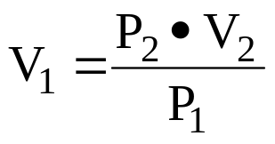
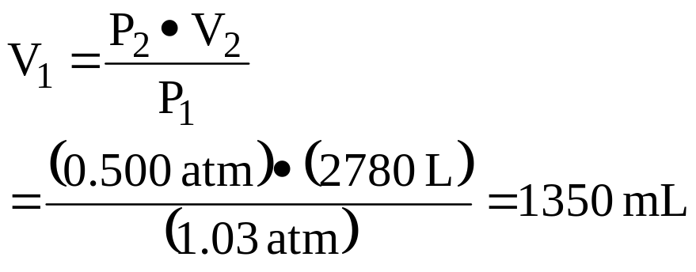
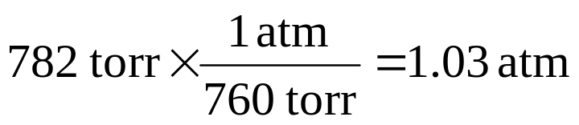
A balloon is put in a bell jar and the pressure is reduced from 782 torr to 0.500 atm. If the volume of the balloon is now 2780 mL, what was it originally?
Given:
Find:
V₂ =2780 mL, P₁ = 762 torr, P₂ = 0.500 atm
V₁, mL
Concept Plan:
Relationships:
P₁ ∙ V₁ = P₂ ∙ V₂ , 1 atm = 760 torr (exactly)
V₁, P₁, P₂
V₂
Solution:
Check:
since P and V are inversely proportional, when the pressure decreases ~2x, the volume should increase ~2x, and it does

Slide 6
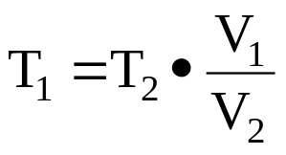
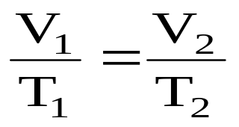
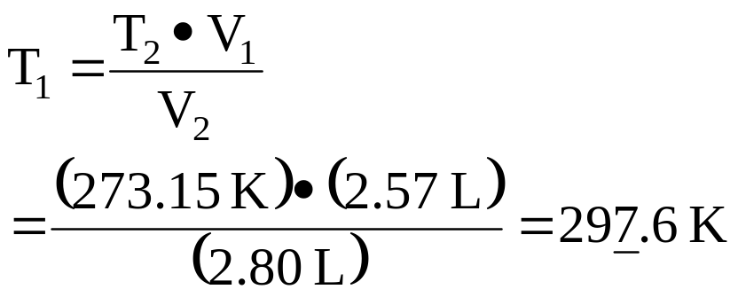
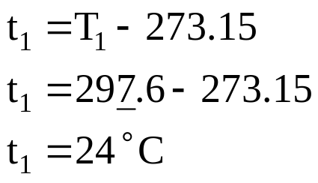
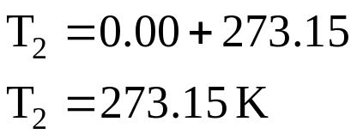
Example 3 – A gas has a volume of 2.57 L at 0.00°C. What was the temperature at 2.80 L?
Given:
Find:
V₁ =2.57 L, V₂ = 2.80 L, t₂ = 0.00°C
t₁, K and °C
Concept Plan:
Relationships:
T(K) = t(°C) + 273.15,
V₁, V₂, T₂
T₁
Solution:
Check:
since T and V are directly proportional, when the volume decreases, the temperature should decrease, and it does

Slide 7
Practice – The temperature inside a balloon is raised from 25.0°C to 250.0°C. If the volume of cold air was 10.0 L, what is the volume of hot air?
Tro, Chemistry: A Molecular Approach

Slide 8
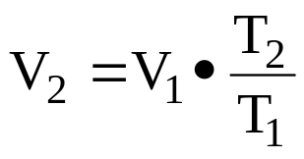
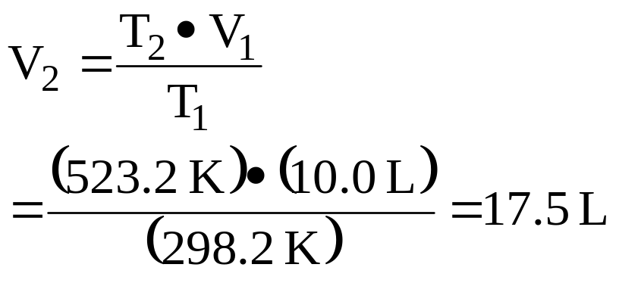
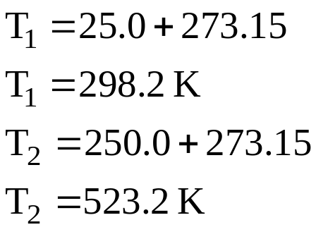
The temperature inside a balloon is raised from 25.0°C to 250.0°C. If the volume of cold air was 10.0 L, what is the volume of hot air?
Given:
Find:
V₁ =10.0 L, t₁ = 25.0°C L, t₂ = 250.0°C
V₂, L
Concept Plan:
Relationships:
T(K) = t(°C) + 273.15,
V₁, T₁, T₂
V₂
Solution:
Check:
since T and V are directly proportional, when the temperature increases, the volume should increase, and it does

Slide 9
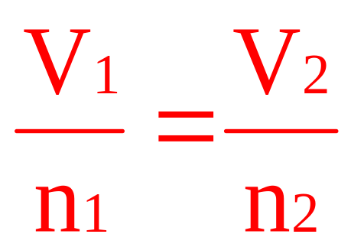
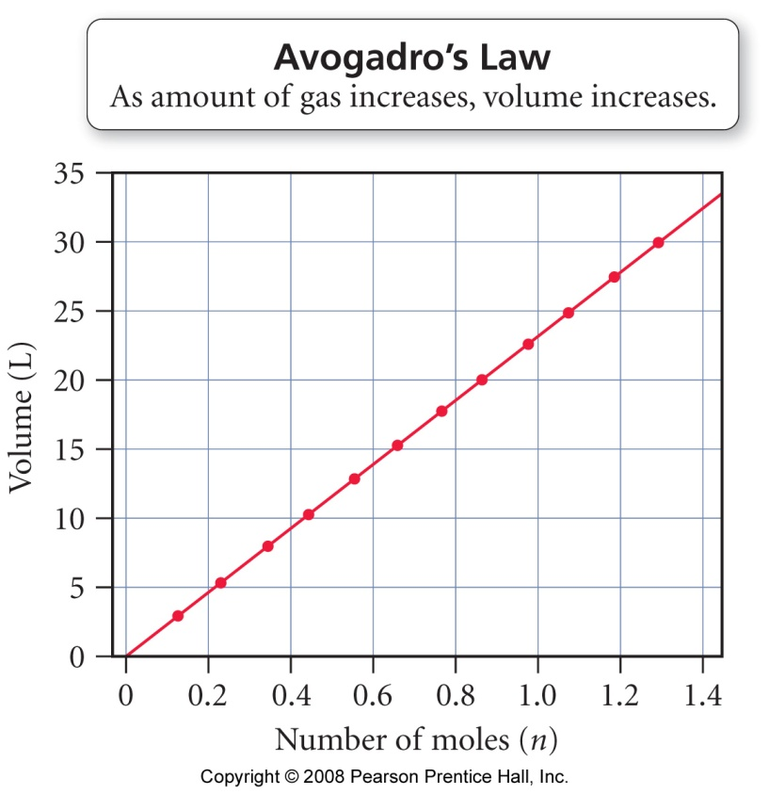
Avogadro’s Law
volume directly proportional to the number of gas molecules
  V = constant x n
  constant P and T
  more gas molecules = larger volume
count number of gas molecules by moles
equal volumes of gases contain equal numbers of molecules
  the gas doesn’t matter
Tro, Chemistry: A Molecular Approach

Slide 10
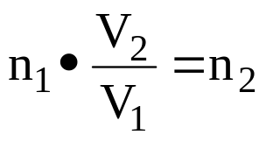
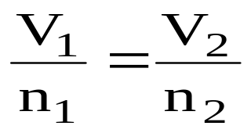
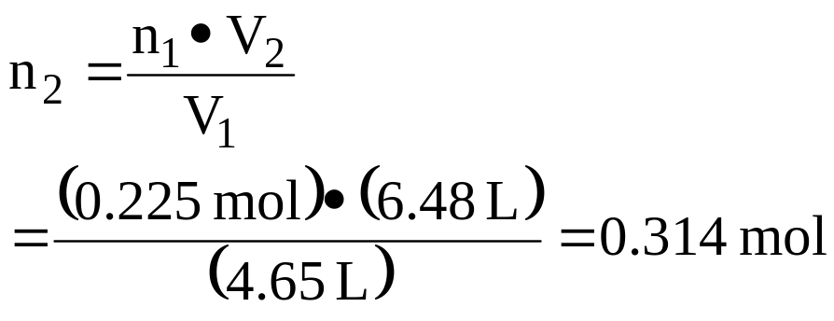
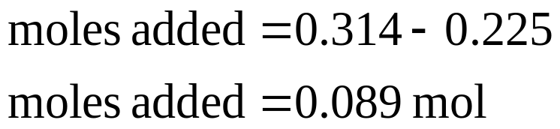
Example 4 – A 0.225 mol sample of He has a volume of 4.65 L. How many moles must be added to give 6.48 L?
Given:
Find:
V₁ =4.65 L, V₂ = 6.48 L, n₁ = 0.225 mol
n₂, and added moles
Concept Plan:
Relationships:
mol added = n₂ – n₁,
V₁, V₂, n₁
n₂
Solution:
Check:
since n and V are directly proportional, when the volume increases, the moles should increase, and it does

Slide 11
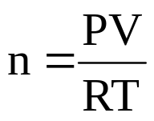

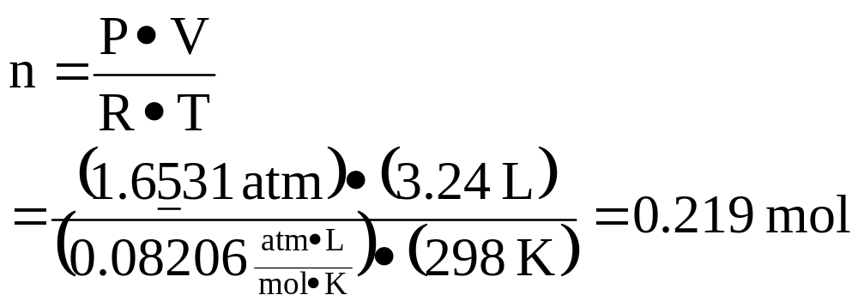
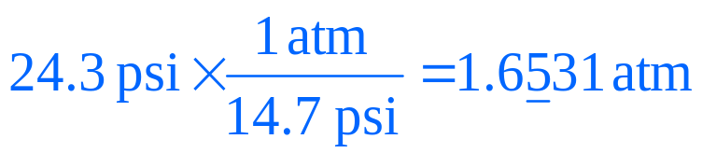
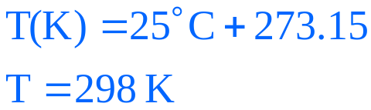
Example 5 – How many moles of gas are in a basketball with total pressure 24.3 psi, volume of 3.24 L at 25°C?
Given:
Find:
V = 3.24 L, P = 24.3 psi, t = 25 °C,
n, mol
Concept Plan:
Relationships:
1 atm = 14.7 psi
T(K) = t(°C) + 273.15
P, V, T, R
n
Solution:
Check:
1 mole at STP occupies 22.4 L, since there is a much smaller volume than 22.4 L, we expect less than 1 mole of gas

Slide 12
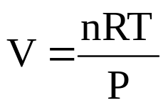
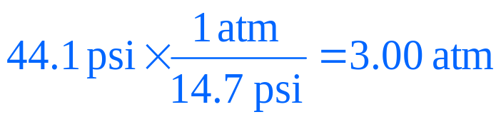
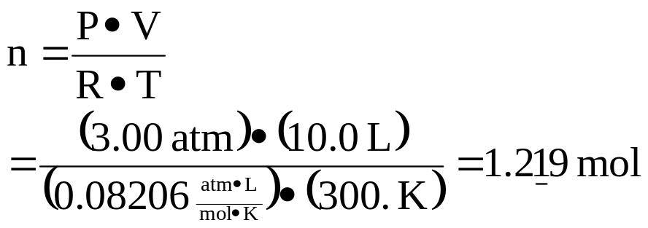
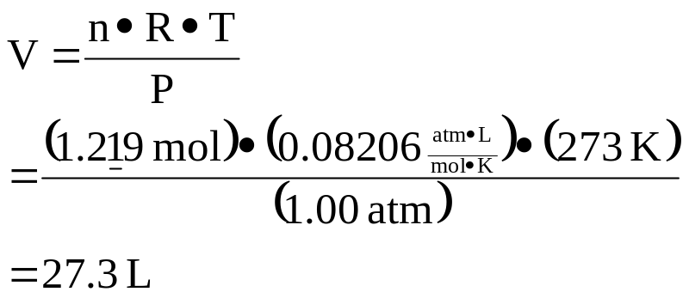
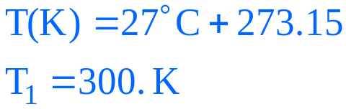
A gas occupies 10.0 L at 44.1 psi and 27°C. What volume will it occupy at standard conditions?
Given:
Find:
V₁ = 10.0 L, P₁ = 44.1 psi, t₁ = 27 °C, P₂ = 1.00 atm, t₂ = 0°C
V₂, L
Concept Plan:
Relationships:
1 atm = 14.7 psi
T(K) = t(°C) + 273.15
P₁, V₁, T₁, R
n
P₂, n, T₂, R
V₂
Solution:
Check:
1 mole at STP occupies 22.4 L, since there is more than 1 mole, we expect more than 22.4 L of gas

Slide 13
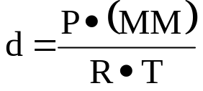
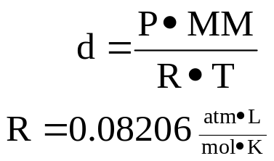
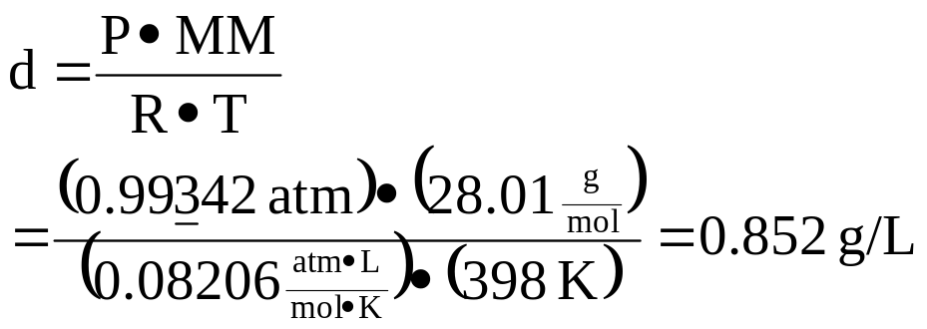
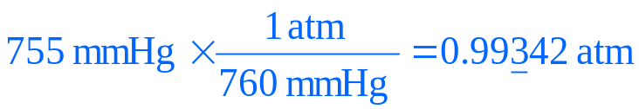
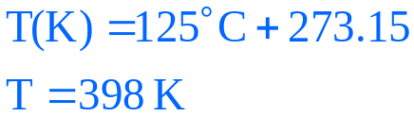
Example 6 – Calculate the density of N₂ at 125°C and 755 mmHg
Given:
Find:
P = 755 mmHg, t = 125 °C,
d_{N2}, g/L
1 atm = 760 mmHg, MM = 28.01 g
T(K) = t(°C) + 273.15
Concept Plan:
Relationships:
P, MM, T, R
d
Solution:
Check:
since the density of N₂ is 1.25 g/L at STP, we expect the density to be lower when the temperature is raised, and it is

Slide 14

Molar Mass of a Gas
one of the methods chemists use to determine the molar mass of an unknown substance is to heat a weighed sample until it becomes a gas, measure the temperature, pressure, and volume, and use the ideal gas law
Tro, Chemistry: A Molecular Approach

Slide 15
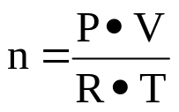
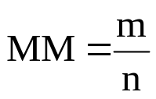
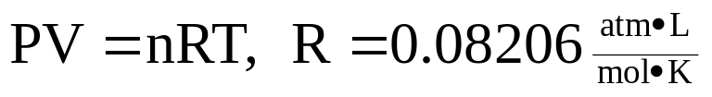
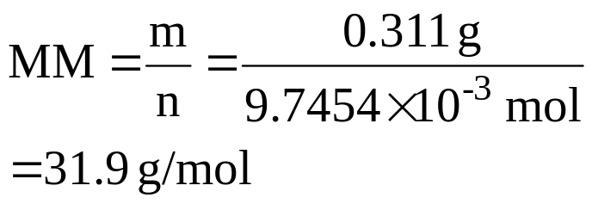
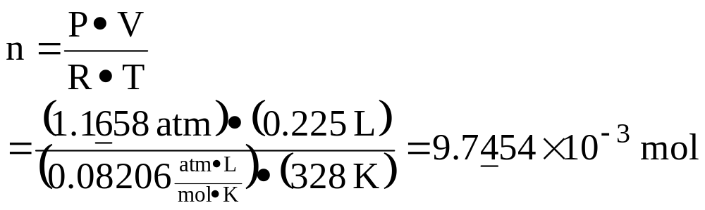
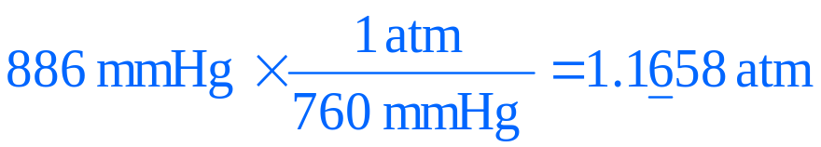
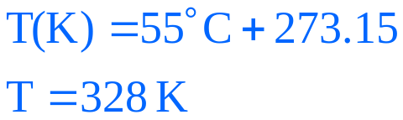
Example 7 – Calculate the molar mass of a gas with mass 0.311 g that has a volume of 0.225 L at 55°C and 886 mmHg
Given:
Find:
m=0.311g, V=0.225 L, P=886 mmHg, t=55°C,
molar mass, g/mol
m=0.311g, V=0.225 L, P=1.1658 atm, T=328 K,
molar mass, g/mol
Concept Plan:
Relationships:
P, V, T, R
n
n, m
MM
1 atm = 760 mmHg,
T(K) = t(°C) + 273.15
Solution:
Check:
the value 31.9 g/mol is reasonable

Slide 16
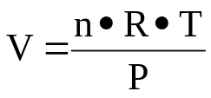
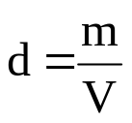
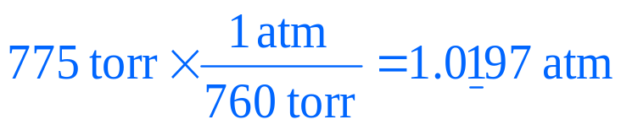
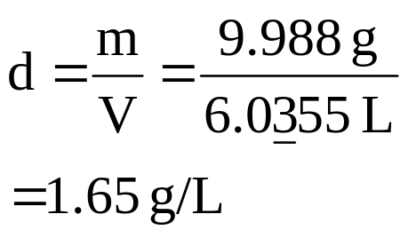
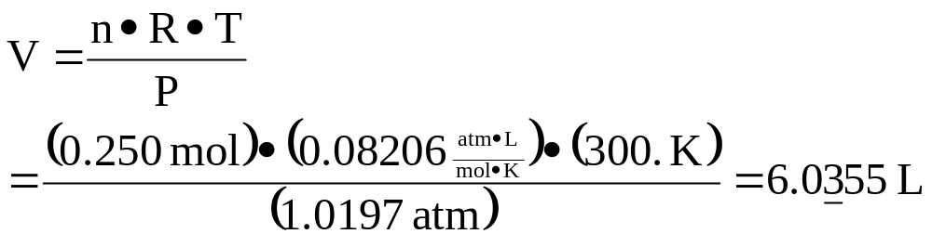
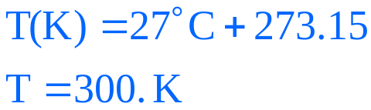
Calculate the density of a gas at 775 torr and 27°C if 0.250 moles weighs 9.988 g
Given:
Find:
m=9.988g, n=0.250 mol, P=775 mmHg, t=27°C,
density, g/L
m=9.988g, n=0.250 mol, P=1.0197 atm, T=300. K
density, g/L
Concept Plan:
Relationships:
P, n, T, R
V
V, m
d
1 atm = 760 mmHg,
T(K) = t(°C) + 273.15
Solution:
Check:
the value 1.65 g/L is reasonable

Slide 17
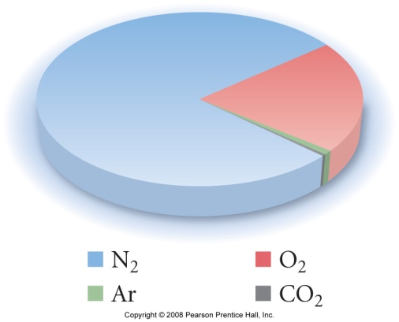
Mixtures of Gases
when gases are mixed together, their molecules behave independent of each other
  all the gases in the mixture have the same volume
    all completely fill the container ∴ each gas’s volume = the volume of the container
  all gases in the mixture are at the same temperature
    therefore they have the same average kinetic energy
therefore, in certain applications, the mixture can be thought of as one gas
  even though air is a mixture, we can measure the pressure, volume, and temperature of air as if it were a pure substance
  we can calculate the total moles of molecules in an air sample, knowing P, V, and T, even though they are different molecules
Tro, Chemistry: A Molecular Approach

Slide 18
Partial Pressure
the pressure of a single gas in a mixture of gases is called its partial pressure
we can calculate the partial pressure of a gas if
  we know what fraction of the mixture it composes and the total pressure
  or, we know the number of moles of the gas in a container of known volume and temperature
the sum of the partial pressures of all the gases in the mixture equals the total pressure
  Dalton’s Law of Partial Pressures
  because the gases behave independently
Tro, Chemistry: A Molecular Approach

Slide 19






Example 8 – Determine the mass of Ar in the mixture
P_{He}=341 mmHg, P_{Ne}=112 mmHg, P_{tot} = 662 mmHg,
V = 1.00 L, T=298 K
mass_{Ar}, g
Given:
Find:
P_{Ar} = 0.275 atm, V = 1.00 L, T=298 K
mass_{Ar}, g
Concept Plan:
Relationships:
P_{tot}, P_{He}, P_{Ne}
P_{Ar}
P_{Ar}, V, T
n_{Ar}
m_{Ar}
P_{Ar} = P_{tot} – (P_{He} + P_{Ne})
P_{tot} = P_{a} + P_{b} + etc.,
1 atm = 760 mmHg, MM_{Ar} = 39.95 g/mol
Solution:
Check:
the units are correct, the value is reasonable

Slide 20
Practice – Find the partial pressure of neon in a mixture with total pressure 3.9 atm, volume 8.7 L, temperature 598 K, and 0.17 moles Xe.
Tro, Chemistry: A Molecular Approach

Slide 21




Find the partial pressure of neon in a mixture with total pressure 3.9 atm, volume 8.7 L, temperature 598 K, and 0.17 moles Xe
Given:
Find:
P_{tot} = 3.9 atm, V = 8.7 L, T = 598 K, Xe = 0.17 mol
P_{Ne}, atm
Concept Plan:
Relationships:
n_{Xe}, V, T, R
P_{Xe}
P_{tot}, P_{Xe}
P_{Ne}
Solution:
Check:
the unit is correct, the value is reasonable

Slide 22
Reactions Involving Gases
the principles of reaction stoichiometry from Chapter 4 can be combined with the gas laws for reactions involving gases
in reactions of gases, the amount of a gas is often given as a volume
  instead of moles
  as we’ve seen, must state pressure and temperature
the ideal gas law allows us to convert from the volume of the gas to moles; then we can use the coefficients in the equation as a mole ratio
when gases are at STP, use 1 mol = 22.4 L
P, V, T of Gas A
mole A
mole B
P, V, T of Gas B
Tro, Chemistry: A Molecular Approach

Slide 23





Ex 9 – What volume of H₂ is needed to make 35.7 g of CH₃OH at 738 mmHg and 355 K?
CO(g) + 2 H₂(g) → CH₃OH(g)
Given:
Find:
m_{CH3OH} = 37.5g, P=738 mmHg, T=355 K
V_{H2}, L
n_{H2} = 2.2284 mol, P=0.97105 atm, T=355 K
V_{H2}, L
Concept Plan:
Relationships:
g CH₃OH
mol CH₃OH
mol H₂
P, n, T, R
V
1 atm = 760 mmHg, CH₃OH = 32.04 g/mol
1 mol CH₃OH : 2 mol H₂
Solution:

Slide 24




Ex 10 – How many grams of H₂O form when 1.24 L H₂ reacts completely with O₂ at STP?
O₂(g) + 2 H₂(g) → 2 H₂O(g)
Given:
Find:
V_{H2} = 1.24 L, P=1.00 atm, T=273 K
mass_{H2O}, g
Concept Plan:
Relationships:
L H₂
mol H₂
mol H₂O
g H₂O
H₂O = 18.02 g/mol, 1 mol = 22.4 L @ STP
2 mol H₂O : 2 mol H₂
Solution:

Slide 25
Practice – What volume of O₂ at 0.750 atm and 313 K is generated by the thermolysis of 10.0 g of HgO?
2 HgO(s) → 2 Hg(l) + O₂(g)
(MM_{HgO} = 216.59 g/mol)
Tro, Chemistry: A Molecular Approach

Slide 26




What volume of O₂ at 0.750 atm and 313 K is generated by the thermolysis of 10.0 g of HgO?
2 HgO(s) → 2 Hg(l) + O₂(g)
Given:
Find:
m_{HgO} = 10.0g, P=0.750 atm, T=313 K
V_{O2}, L
n_{O2} = 0.023085 mol, P=0.750 atm, T=313 K
V_{O2}, L
Concept Plan:
Relationships:
g HgO
mol HgO
mol O₂
P, n, T, R
V
1 atm = 760 mmHg, HgO = 216.59 g/mol
2 mol HgO : 1 mol O₂
Solution:

